Slide 1
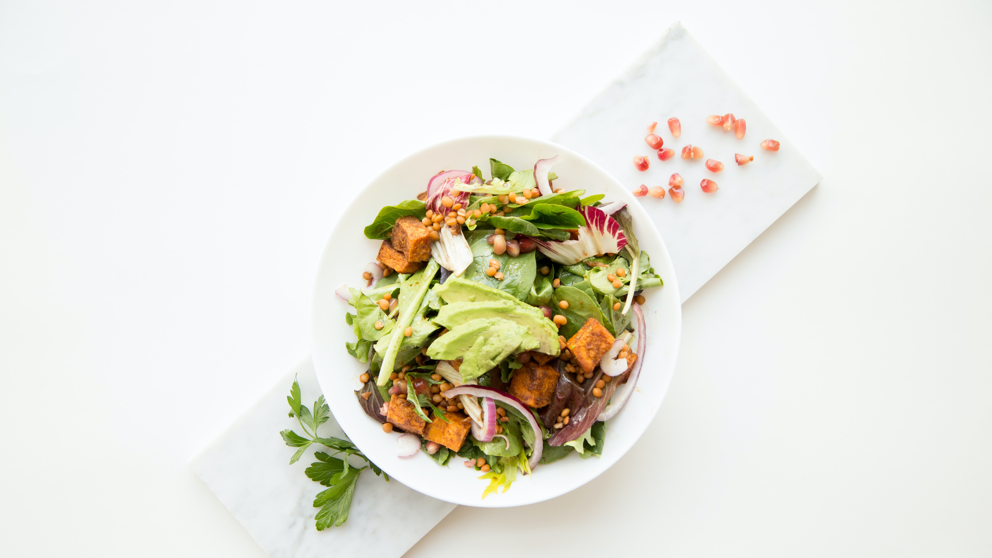
Recipe Blogging System
THE FOOD STORY
By
Gaurav Yadav – 12113023
Aparna Tijo – 12110988
Pranjal Singh - 12104223

Slide 2
Recipe Blogging System
Java Project
CSE 310
Under the Guidance of
Dr. Ranjith Kumar A

Slide 3
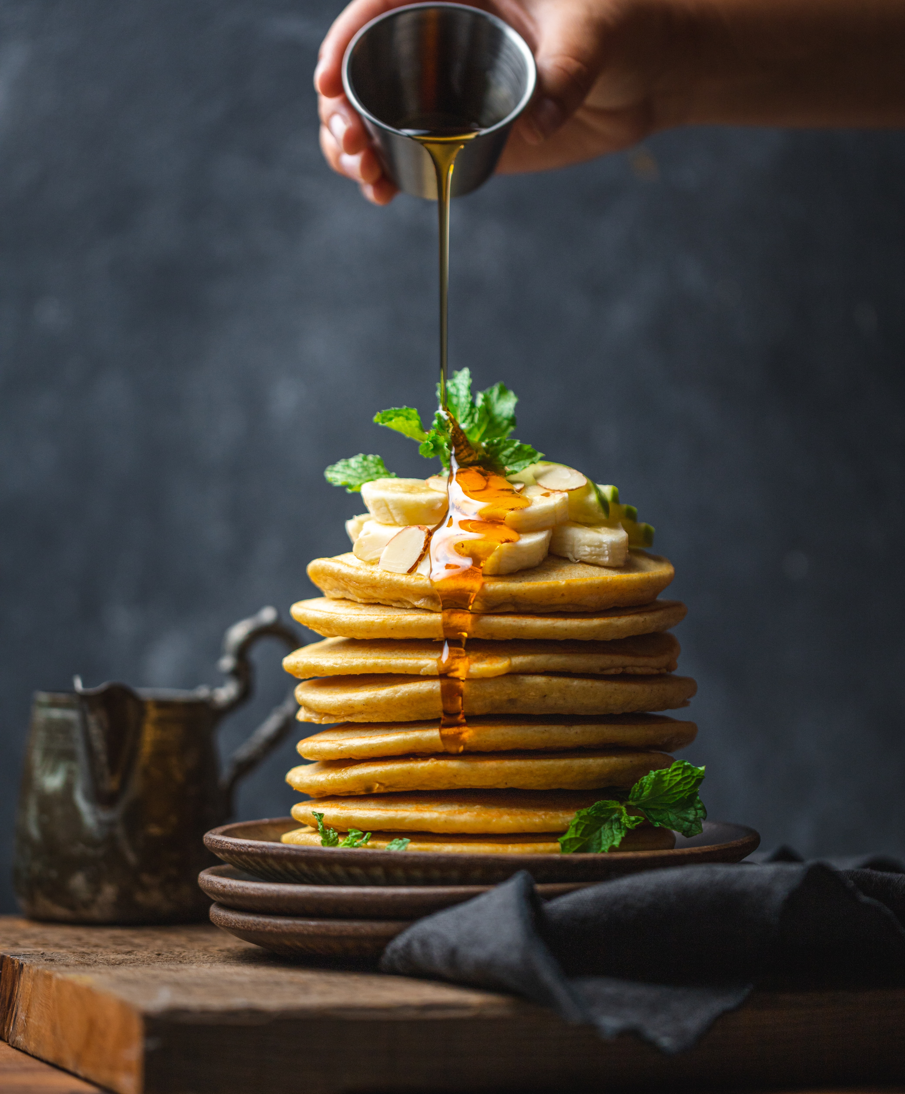
Introduction
Our project “Food Blogging System” aims to be a food blogging interface, where foodies can come together and upload their favorite recipes online. The main purpose of our project is to automate the existing manual system with the help of computerized equipment and full fledged computer software, which will fulfill certain requirements. Additionally, our project also connects with the database, hence input data from various users can be stored inside the database securely. Essentially, this project “The Food Blogging System” strives to provide good performance and better services for its users.

Slide 4
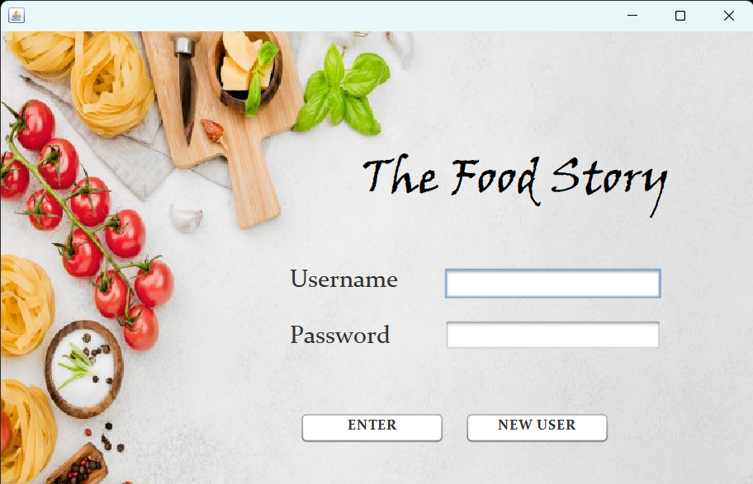
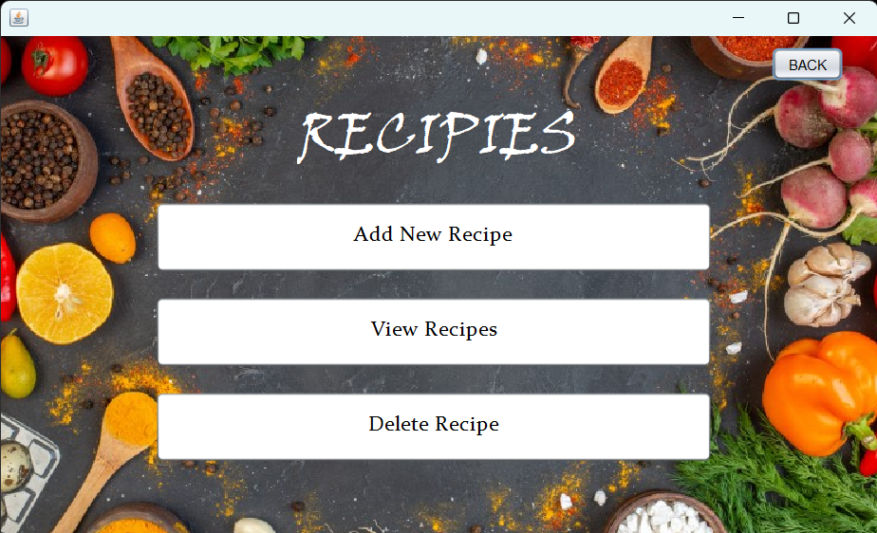
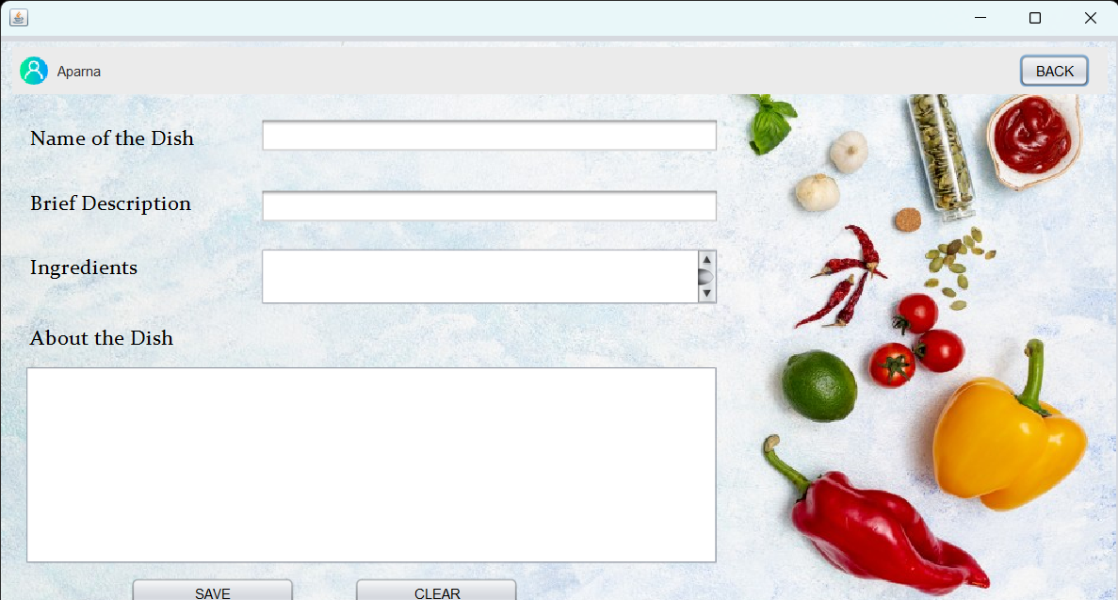
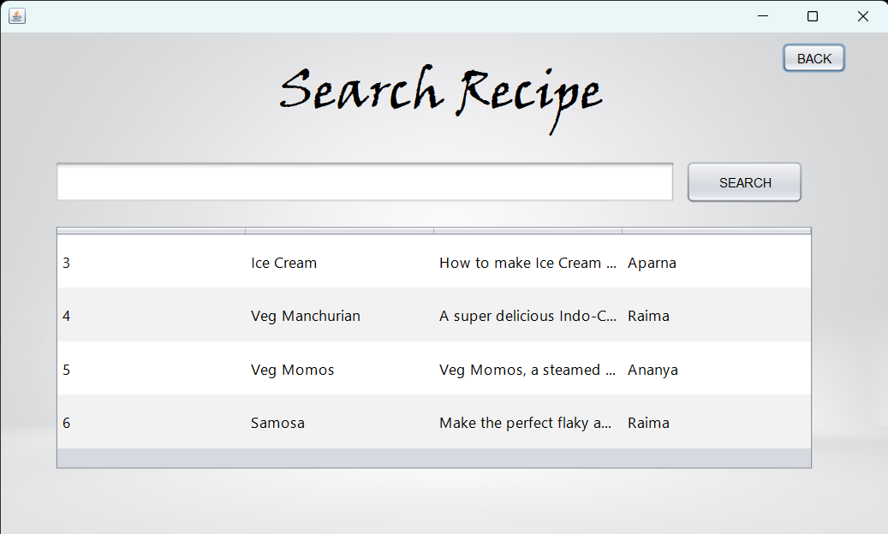
SEARCH
RECIPE
ADD
RECIPE
COMMON
ROOM
LOGIN MODULE

Slide 5
SEARCH
RECIPE
ADD
RECIPE
COMMON
ROOM
LOGIN MODULE

Slide 6
SEARCH
RECIPE
ADD
RECIPE
COMMON
ROOM
LOGIN MODULE

Slide 7
SEARCH
RECIPE
ADD
RECIPE
COMMON
ROOM
LOGIN MODULE

Slide 8
The Login Module
In the Login Module, the user has to enter their username and password to log into their respective accounts. In case of wrong username or password, an error message is generated using the JOptionPane Library which prompts the user to re-enter their username and password until they manage to get it right. In case of a new user, we have a different module known as the ‘Sign up’ Module which allows new users to create their account into our database. After entering their credentials, new users will be redirected to the Login Module, from where they can access their newly created account.

Slide 9
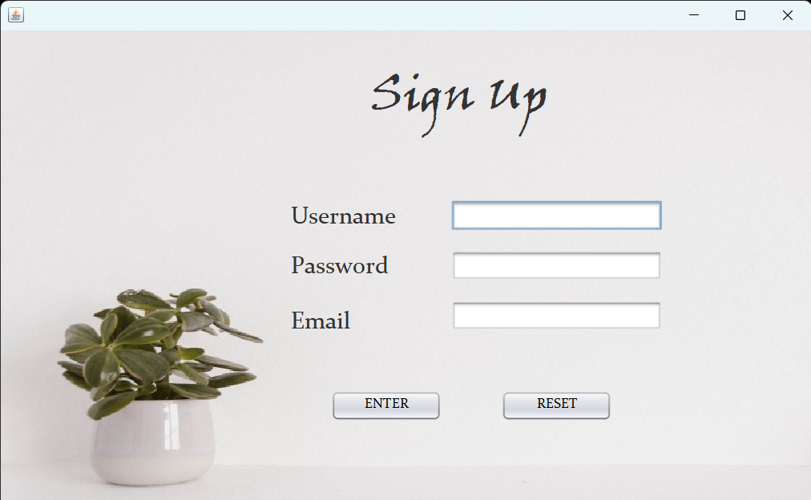
The Sign Up Module

Slide 10
The Common Room Module
In the Common Room Module, the user has three options to choose from. Starting with the ‘Add New Recipe’, ‘View Recipe’ and the ‘Delete Recipe’. Add New Recipe, as the name suggests, allows the user to add new recipes into their profile. The View Recipe, displays all the recipes from the entire database. All the recipes created by different users can be viewed using this module. Using Delete Recipe Module, the user can delete only the recipes created by them, which they no longer want in their account. However, deleting a recipe will remove it completely from the system database.

Slide 11

The Add New Recipe Module
The Add New Recipe Module allows the user to add new recipes into their account. The users are provided with four empty spaces, where they have to fill in the details of their recipe.
Name of the Dish
Brief Description
Ingredients
About the Dish

Slide 12
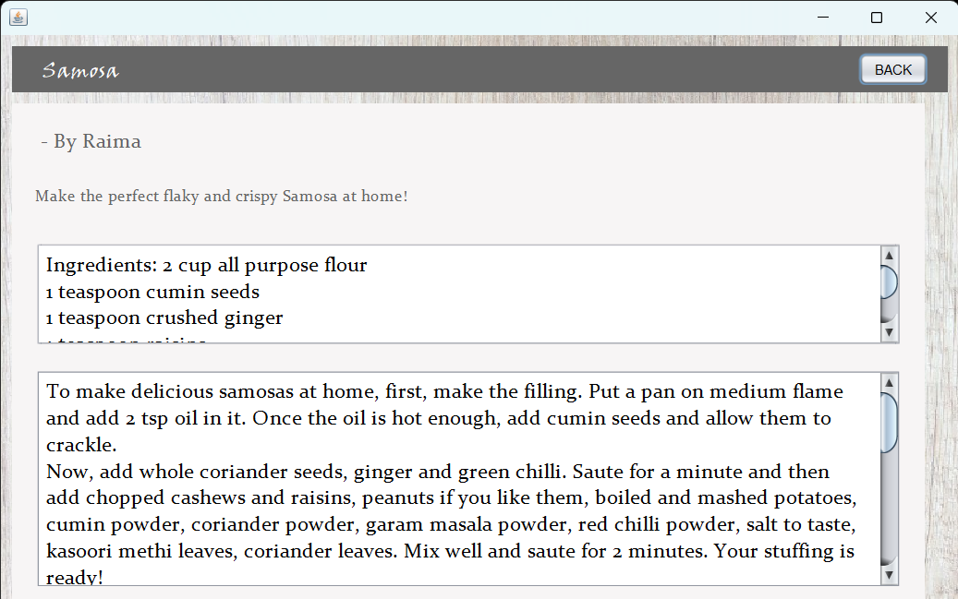
The View Recipe Module
The View Recipe Module directs the user to the search recipe module, where the user can type in any available recipes. From here, the project directs the user to the particular recipe that the user searched for.

Slide 13
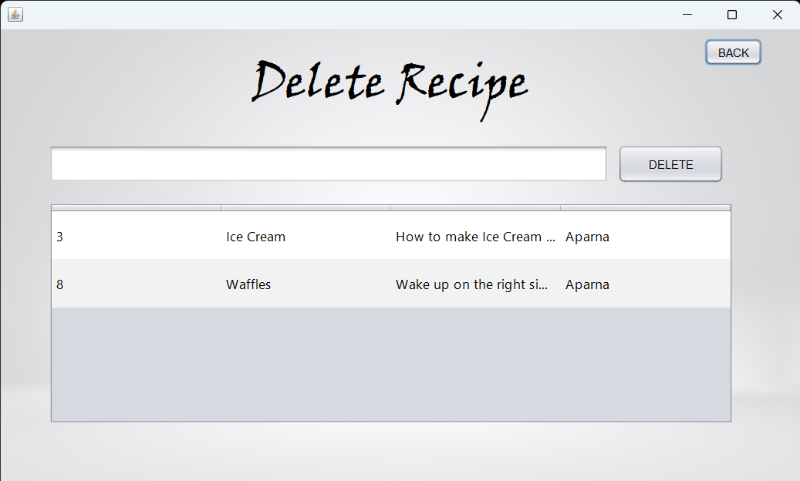
The Delete Recipe Module
The Delete Recipe allows the user to delete only the recipes created by that particular user. A user cannot delete another user’s recipe.
Deleting a recipe from the user profile will completely remove the recipe from the entire database

Slide 14
FUTURE SCOPE
We can add more advanced features for Recipe Blogging System which will include more facilities.
We can host the project on a website.
Integrate multiple load balancers to distribute the loads of the system.
Implement various database methods like the master and slave database structure to reduce the overload of the database queries.

